Slide 1
COMP814 Text Mining LaTeX workshop
Writing an Assignment in LaTeX

Slide 2
How this workshop runs
This is a hands-on workshop. Feel free to go ahead at your own speed. Just ask if you need help.
We are first going to build a simple document, from scratch, in a popular LaTeX development system called Overleaf.
We are then going to use the IEEE Conference LaTeX template to create your assignment on Overleaf:
Along the way, you will progressively add more LaTeX features and try them out in-context. You will create sections, sub-sections and graphics step-by-step.
Referencing in LaTeX is much simpler and easier than the way tools like EndNote do it in Microsoft Word. We will use BibTeX to manage citations.
There are great, free resources available to help you keep learning. We will look briefly at how to find the best ones to keep you going.

Slide 3
Overleaf is free
The first step is sign up for a free Overleaf account

Slide 4
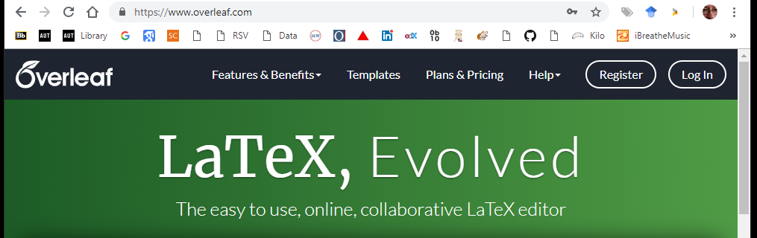
Sign up for a free Overleaf account
Overleaf is a free on-line LaTeX editor that is a great place to learn LaTeX:
Visit www.overleaf.com and click SIGN UP.
Create a free account using your name and your email address.
one

Slide 5
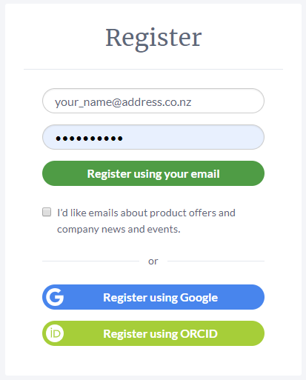
Sign up for a free Overleaf account
Use an email account that you can check today on this course. Overleaf requires you to verify your address:
two
This password is your new Overleaf password, NOT your private email password.
three
four

Slide 6
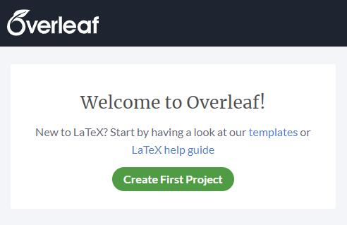

Last step – Verify your Overleaf account
Overleaf needs you to verify your account by answering the email they have just sent you:
Check your email account for a new email from welcome@overleaf.com.
Click the text in the email:
Your can write down your Overleaf ID and password here so you do not forget it.
fffffffgdbdvbdgsrgweszxfgdew4r3wefxfsdsdfrewrerewrerewewrreewrfcxwsaerdfe3fdsfsdfsdfsfsd

Slide 7
The first document
We are first going to build a simple document, from scratch, in Overleaf.

Slide 8
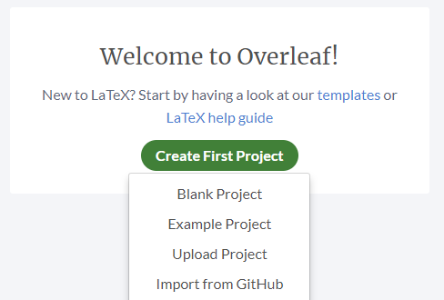
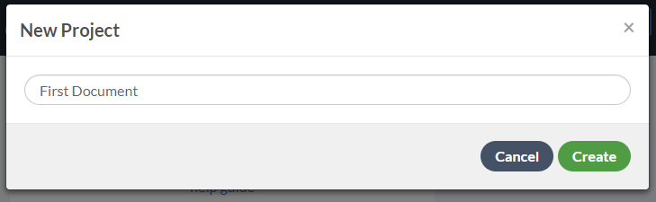
Creating our first document in Overleaf
Before we learn how LaTeX works, we need to create a project to hold our documents in:

Slide 9
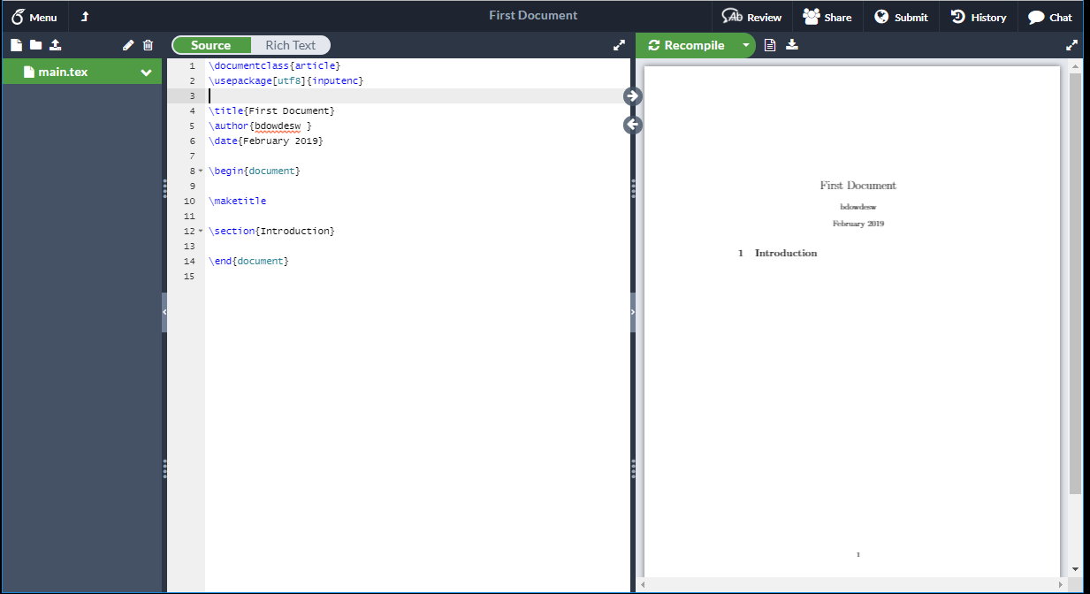
Creating our first document in Overleaf
This is where you type LaTeX commands
This is the PDF document that Overleaf creates from your LaTeX commands

Slide 10

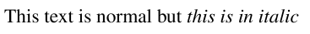
Introducing LaTeX commands
LaTeX (pronounced Lay-tech) is a document markup language. In contrast, Microsoft Word is a WYSIWYG (what-you-see-is-what-you-get) editor. In Word, you make text italic by highlighting it and pressing Ctrl I like this:
In LaTeX, you mark your source text like this:
Overleaf compiles your LaTeX source to typeset the document like this:
This simple command structure \commandName{ } is used all throughout LaTeX. Since all commands have the same shape, they are easier to remember.

Slide 11

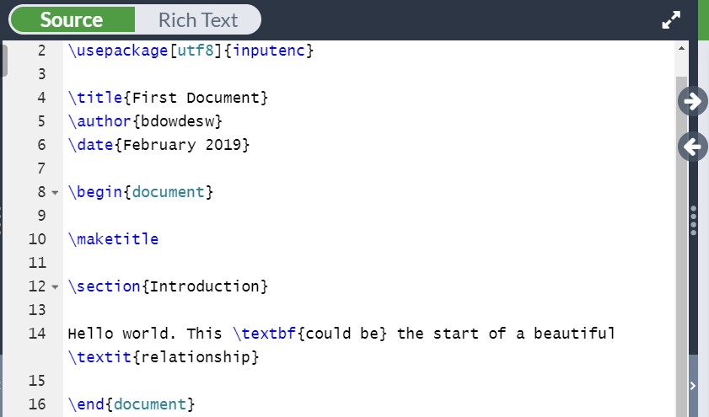
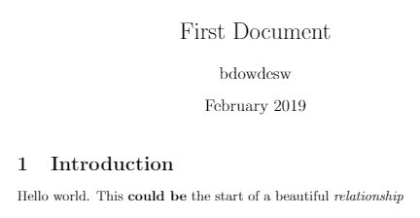
Text with Bold and Italic fonts
Type this sentence then click Recompile to see the result in your document on the right-hand side.

Slide 12
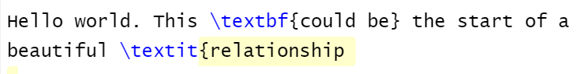

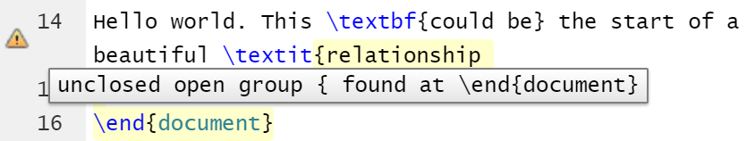
What happens if I make a mistake?
Overleaf will try to tell you what is wrong if you make a mistake:
Try this. Remove the end bracket } from the command:
Hover over the symbol in the left-hand border:

Slide 13
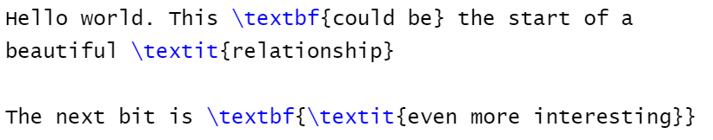
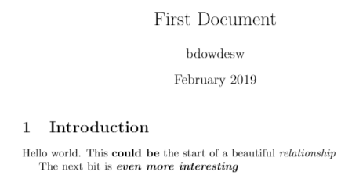
Combining LaTeX commands
We can combine LaTeX commands together for extra effects:
Don’t forget to balance your brackets !!!

Slide 14
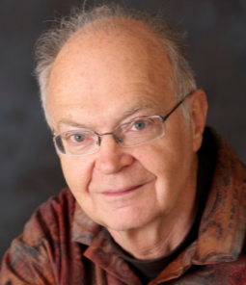
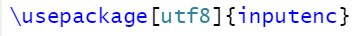
A simple observation about LaTeX
The creator of LaTeX, Professor Donald Knuth is a LaTeX expert… You and I are not… not yet…
That is why we did not really start with a blank document. At the top of the page it says it wants to use a LaTeX package:
Packages are collections of useful commands you can add to your documents. This inputenc package helps LaTeX create all sorts of font characters when it is formatting documents.

Slide 15
LaTeX Packages
The LaTeX Package is a powerful concept

Slide 16
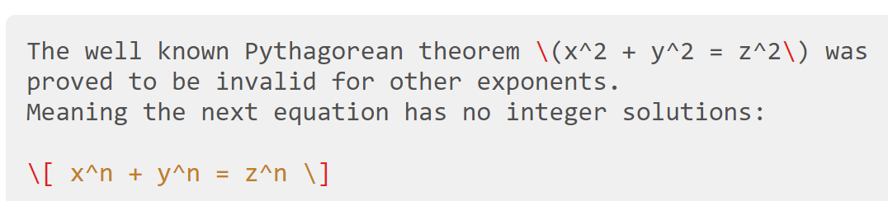
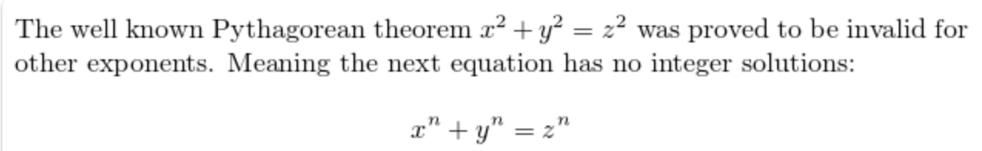
There are hundreds of great, free LaTeX packages
LaTeX is great for equations! The American Mathematical Society amsmath package enables you to layout elegent equations, sets, tuples, algorithms and functions.
Writing equations is covered in another course, but here is a taste of what LaTeX mathematics looks like:

Slide 17
Creating an IEEE conference paper
Your Assignment will be written as an IEEE Conference paper.

Slide 18

This is where we create your A+ assignment
The images and other resources you need to easily create this double-column IEEE conference paper are in the folder you will download from AUT Blackboard next.
The instructions are on the following pages.

Slide 19
Resources for this course
All the resources and notes for this course are available onCanvasRight-Click the file

Slide 20
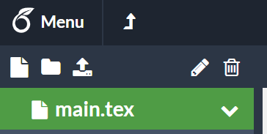
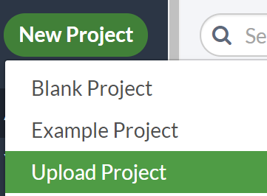
Uploading Assignment to Overleaf – step one
We are going to create your assignment by uploading the blank COMP814_Assignment_1.zip project file to Overleaf:
Go back to My Projects in Overleaf by clicking the arrow,
Click New Project then choose Upload Project

Slide 21
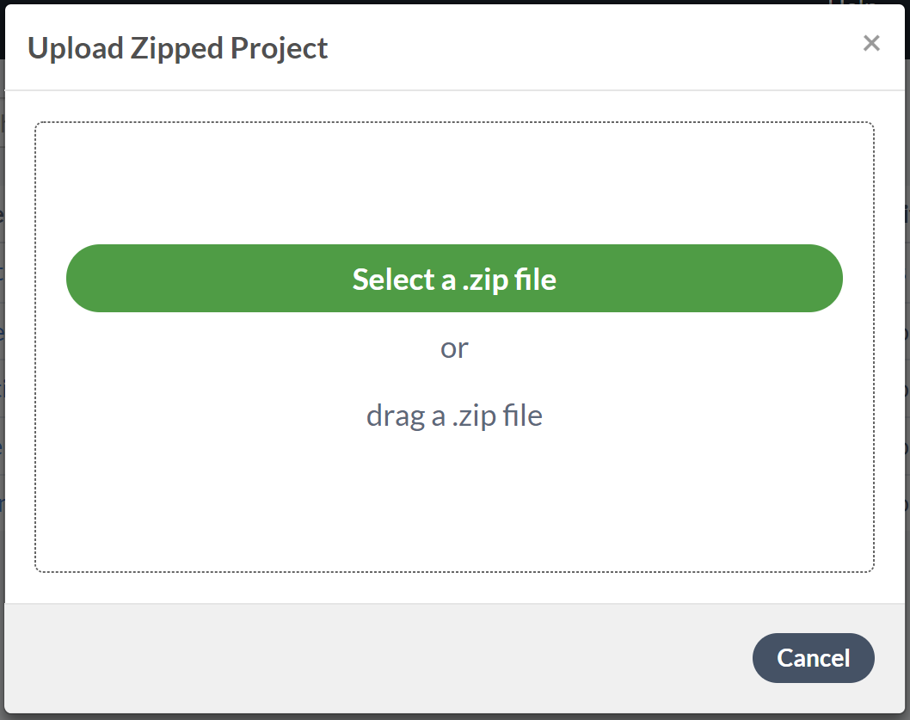
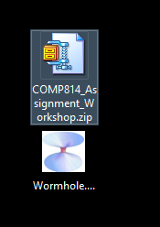

Uploading Assignment to Overleaf –– step two
Drag the file COMP814_Assignment_1.zip from your computer to Overleaf
When it uploads, you will have a two-column conference paper as your own project, based on the IEEE LaTeX template.

Slide 22
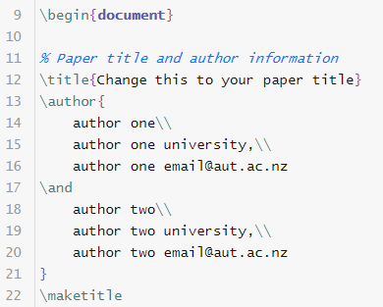
Customising the paper title and author
Change the paper title, your name and add the names of your assignment partner. The commands like \title{} and \author{} has been created to format the text in the correct IEEE style:
\\ starts a new line.
Note how the line numbers show you where we are working.

Slide 23
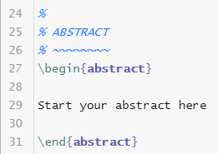

Writing your abstract section
Write a brief Abstract for your paper here:
This part of the paper is called the Abstract section. It starts with a \begin{abstract} command. Write your paper abstract here.
The abstract section ends with the matching \end{abstract} command.

Slide 24
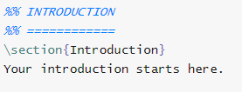
Writing your Introduction section
Now we can write our Introduction section here:
Start writing on the next line after \section{Introduction}

Slide 25
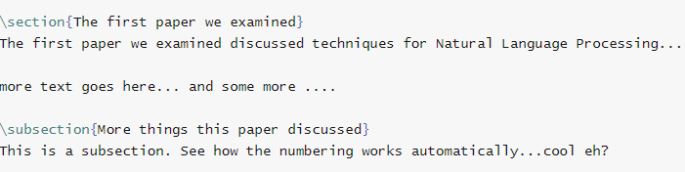
Writing your own named section
Now you can create another named section by typing it yourself like this:
You can also create subsections, as many as you want. Note that there is no end of section or subsection marker… just start a new one. LaTeX figures it all out by itself.

Slide 26
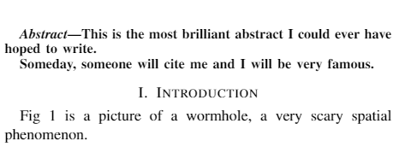
Navigating around
Now your paper is getting bigger, you need to learn how to navigate around easily. Try these Overleaf tricks:
As you hover over a section of your paper, a large cross will follow your mouse cursor. Click and Overleaf will take you to that part of the editor window.

Slide 27
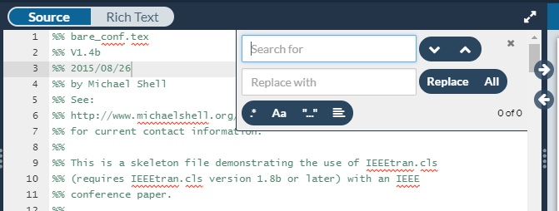
Navigating around
There is an Overleaf Find command. Hold down the Ctrl key and press F. The search and replace box will appear:

Slide 28
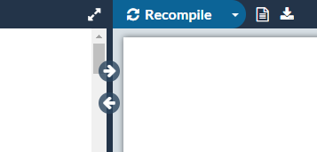
Navigating around
The arrow buttons open and close screen panes to give you more room to work on smaller laptop screens:

Slide 29
Graphics in LaTeX
We are going to add some images to our IEEE paper.

Slide 30
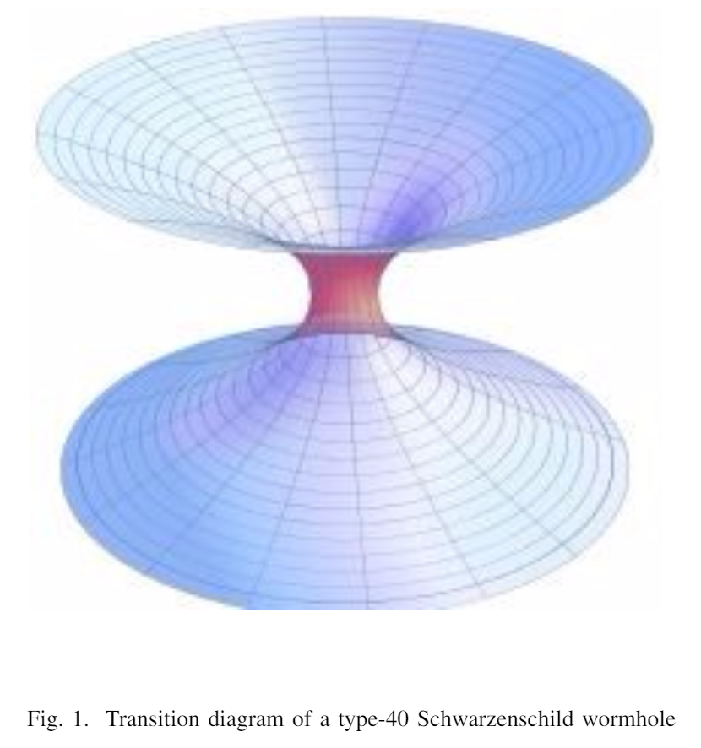
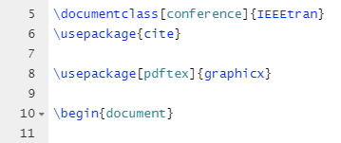
Loading the LaTeX graphics package
You must load the LaTeX graphicx package first. Add this line to your document:
Note that this line must go before the \begin{document} command.

Slide 31
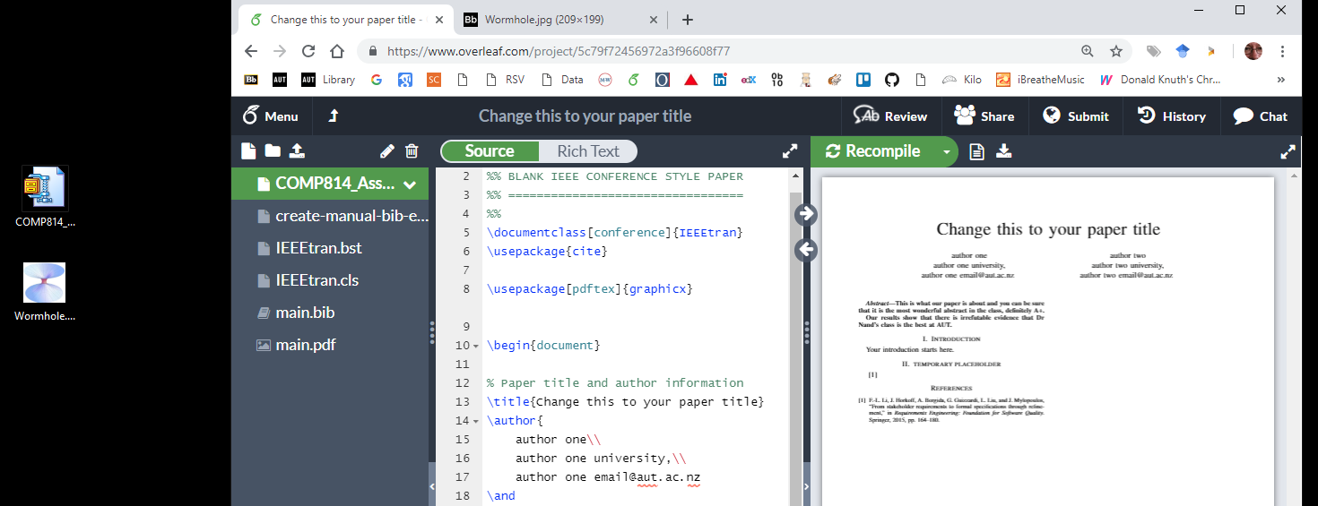
Loading images into Overleaf – step one
Before we can display an image, we have to load it into Overleaf. First, resize your Overleaf browser window so you can see your desktop also.

Slide 32
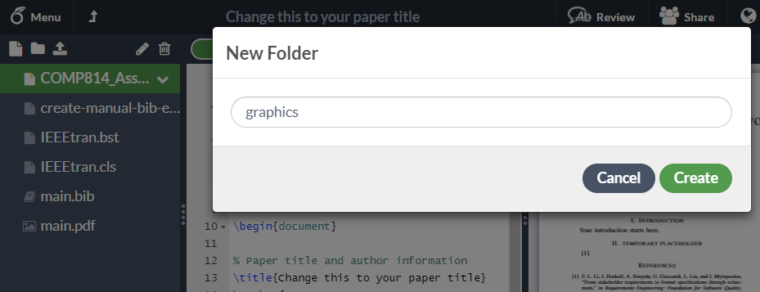
Loading images into Overleaf – step two
Create a new Overleaf folder called graphics to hold your images:

Slide 33
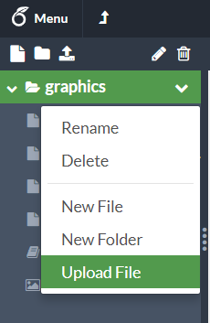
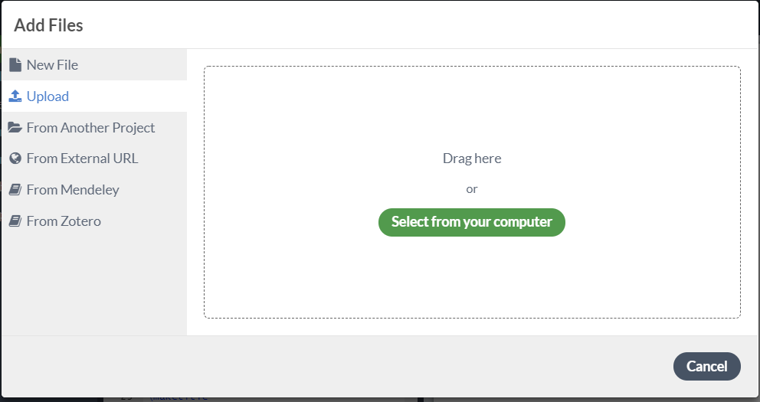
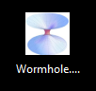
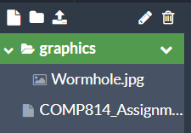
Dragging images into Overleaf – step three
Click the menu arrow and drag the image from your Desktop to the upload window:
It will then appear in the graphics folder:

Slide 34
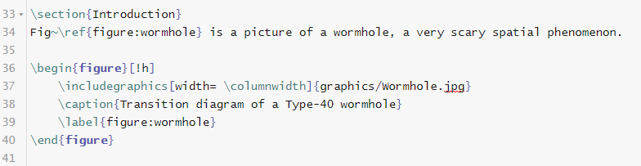
Putting the image in your assignment paper
Insert the image in the middle of some text in your paper using the \begin{figure} command:

Slide 35
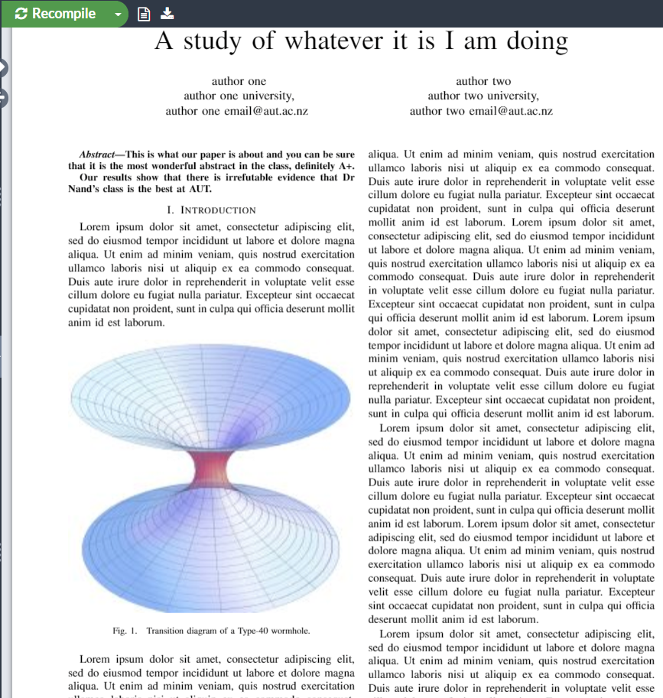
More images in your assignment paper
Now add another image somewhere else in your paper. The \ref{figure:wormhole} command and the \label{figure:wormhole} command allow you to reference named images in your paper.
LaTeX numbers these images automatically and renumbers them when you move them to a new section.

Slide 36
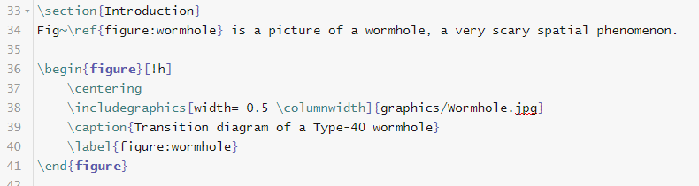
More graphics commands for your paper
Put the image at the bottom of the column \begin{figure}[!b]
or...
Put the image at the top of the page \begin{figure}[!t]
Center the image and make it half the current size:

Slide 37
Citations and references
Managing citations and references in LaTeX is very simple.

Slide 38
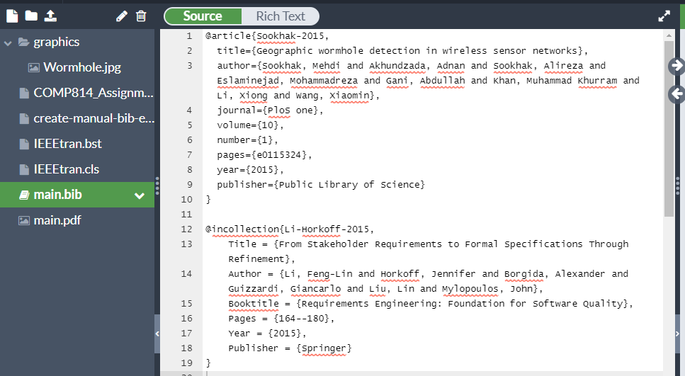
Citations and referencing
LaTeX has its own referencing system called BibTeX. It has commands like LaTeX that are processed as your document is created.
The IEEE class style determines the citation style and reference list style that is output. Open the bibliographic section of the document:

Slide 39
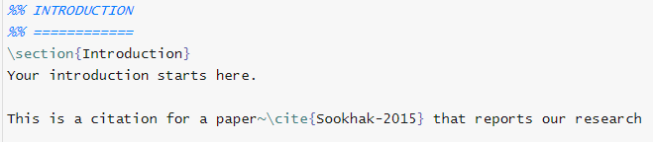
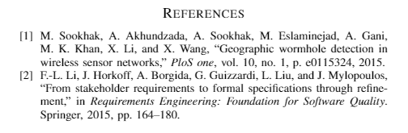
Inserting citations into chapters
Go back to your Introduction section and cite some authors

Slide 40
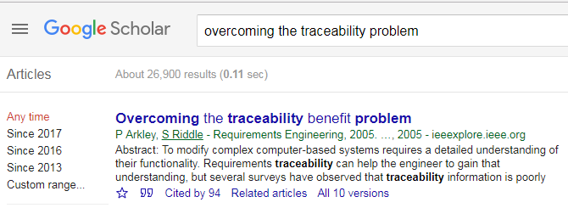
Where did you get those citations from?
You can find more BibTeX-format citations on Google Scholar while you are performing a literature search:

Slide 41
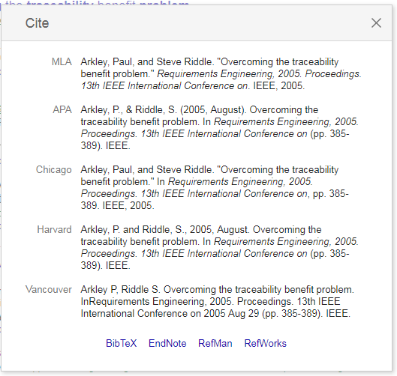
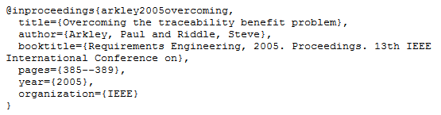
BibTeX-format citations
You can select and copy the BibTeX-format citations and paste them into your main.bib document.

Slide 42

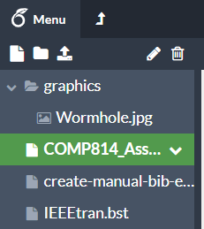

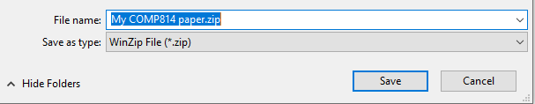
Two final steps..
You can download a PDF-format version of your assignment by using this option:
You can also save all your work as a ZIP-format file and download it to keep backup copies:

Slide 43
The next steps
We have only looked at a few of the capabilities of LaTeX.
This next section looks at where to find LaTeX resources.

Slide 44
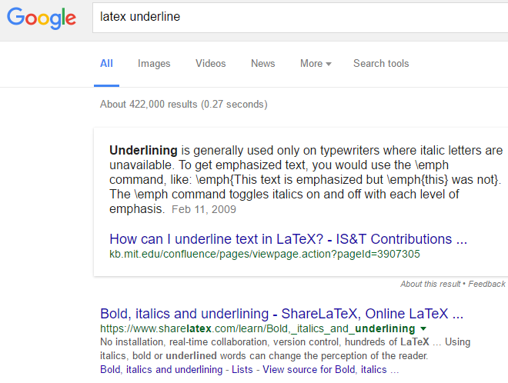
LaTeX on the web
CTAN is the Comprehensive TeX Archive Network, the main repository of LaTeX resources. Our AUT mirror is at http://mirror.aut.ac.nz/ctan
The latest AUT Thesis template is always available from http://aut.ac.nz.libguides.com/computer/LaTeX
Wikibooks for LaTeX https://en.wikibooks.org/wiki/LaTeX
Prefixing your Google searches with the term LaTeX helps to narrow the search:

Slide 45

LateX in ninety minutes
This workshop was adapted from the standard AUT LaTeX workshop we teach called LaTeX in ninety minutes. When you start your Master’s or Honors Dissertation, give me a call and book a session. The workshop covers how to create your AUT Thesis in LaTeX.

